Slide 1


Real Estate Portfolio TooL Minimum Viable Product Nick Baronti April 2022

Slide 2

Project Overview & Objectives
WHAT IS THE REAL ESTATE PORTFOLIO TOOL?
PROJECT GOALS | WHY DEVELOP THIS TOOL?

Slide 3
Project Approach
Six Step Approach for Calculations & Visualizations:
Step 1: Populate Excel import template (multi-tab workbook). Step 2: Read Excel data into Python (parsing into individual CSVs). Execute schema and query SQL scripts and export data to PostgreSQL using SQLalchemy. Step 3: PostgreSQL database houses all portfolio data in normalized form with primary and foreign key connections for all tables. Step 4: Data is queried from created Views in PostgreSQL and read back into Python. Calculations are then run on the aggregated View data. Step 5: Front-end user interface is driven in Streamlit with ability to select calculation types, portfolio details, and scenarios. Step 6: End user can export calculations into Excel report.
1. MS Excel
Import Data
3. PostgreSQL
Aggregate & Query Data
4. Python
Calculations
5. Streamlit
Front-End UI
6. MS Excel Export Report
2. Python
Read Data

Slide 4
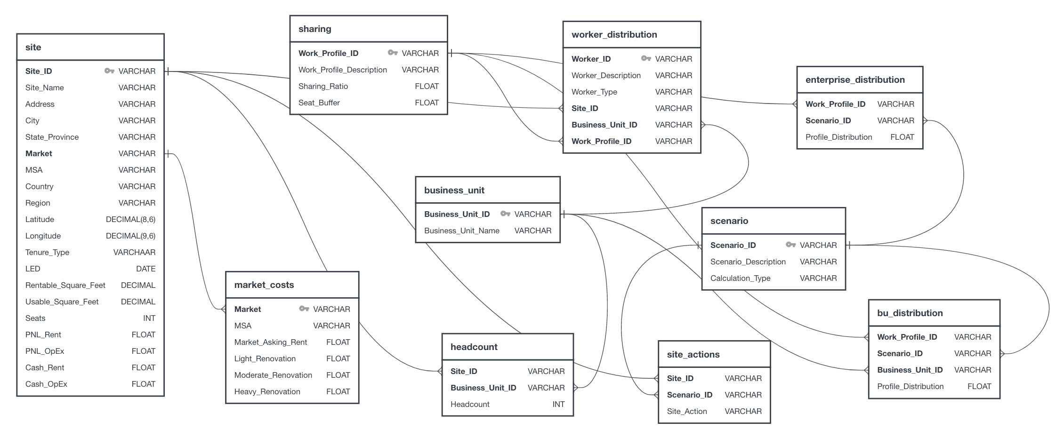
Relational Database Diagram (PostgreSQL)

Slide 5
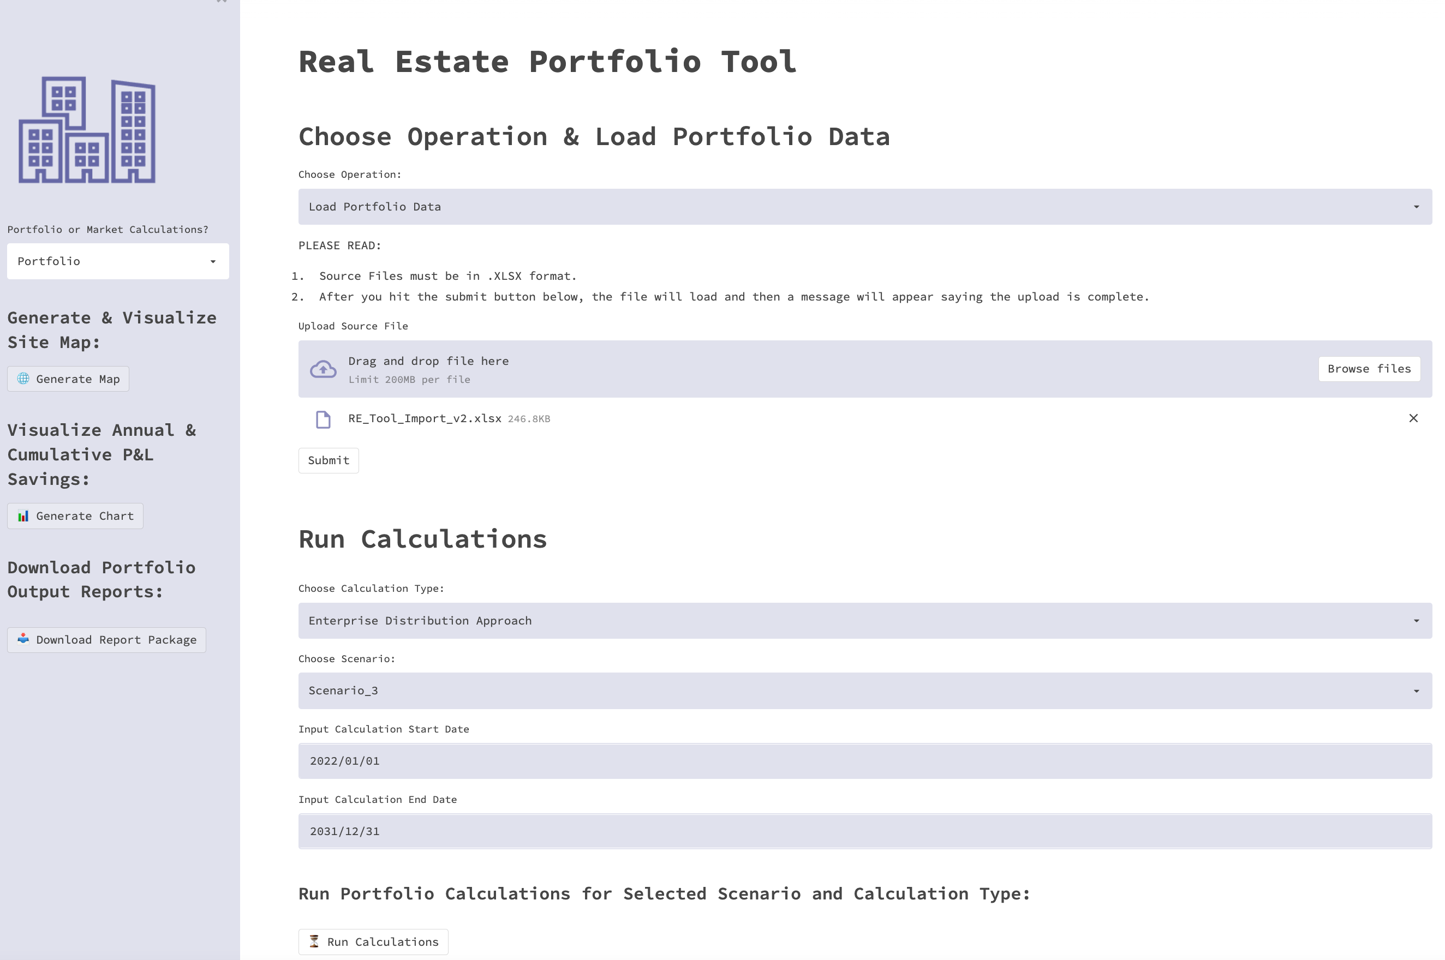
Key Outcomes – Streamlit Application
Streamlit User Interface
Upload Excel data using file browser. Click submit to read Excel data and query the data to PostgreSQL. Select either Portfolio or Market-level calculations in the left side bar. If Market-level is selected, an additional drop down will display to select a market based on the imported data. Prior to running calculations, select calculation type to perform, scenario, and input calculation start and end dates Run calculation and view/download reports

Slide 6
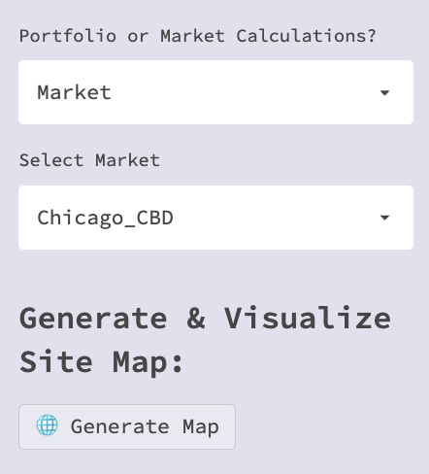
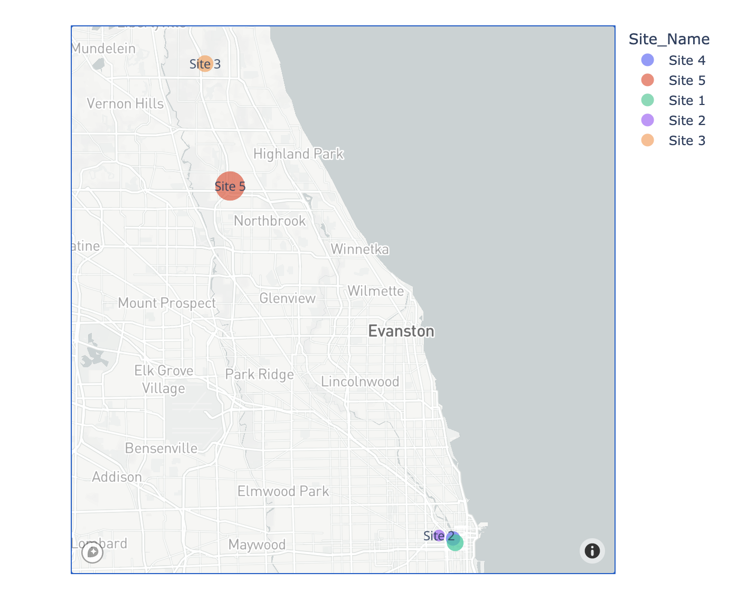
Output Analytics (Portfolio Map)
Select Market or Portfolio:
Current Portfolio Map (Based on Selection):

Slide 7
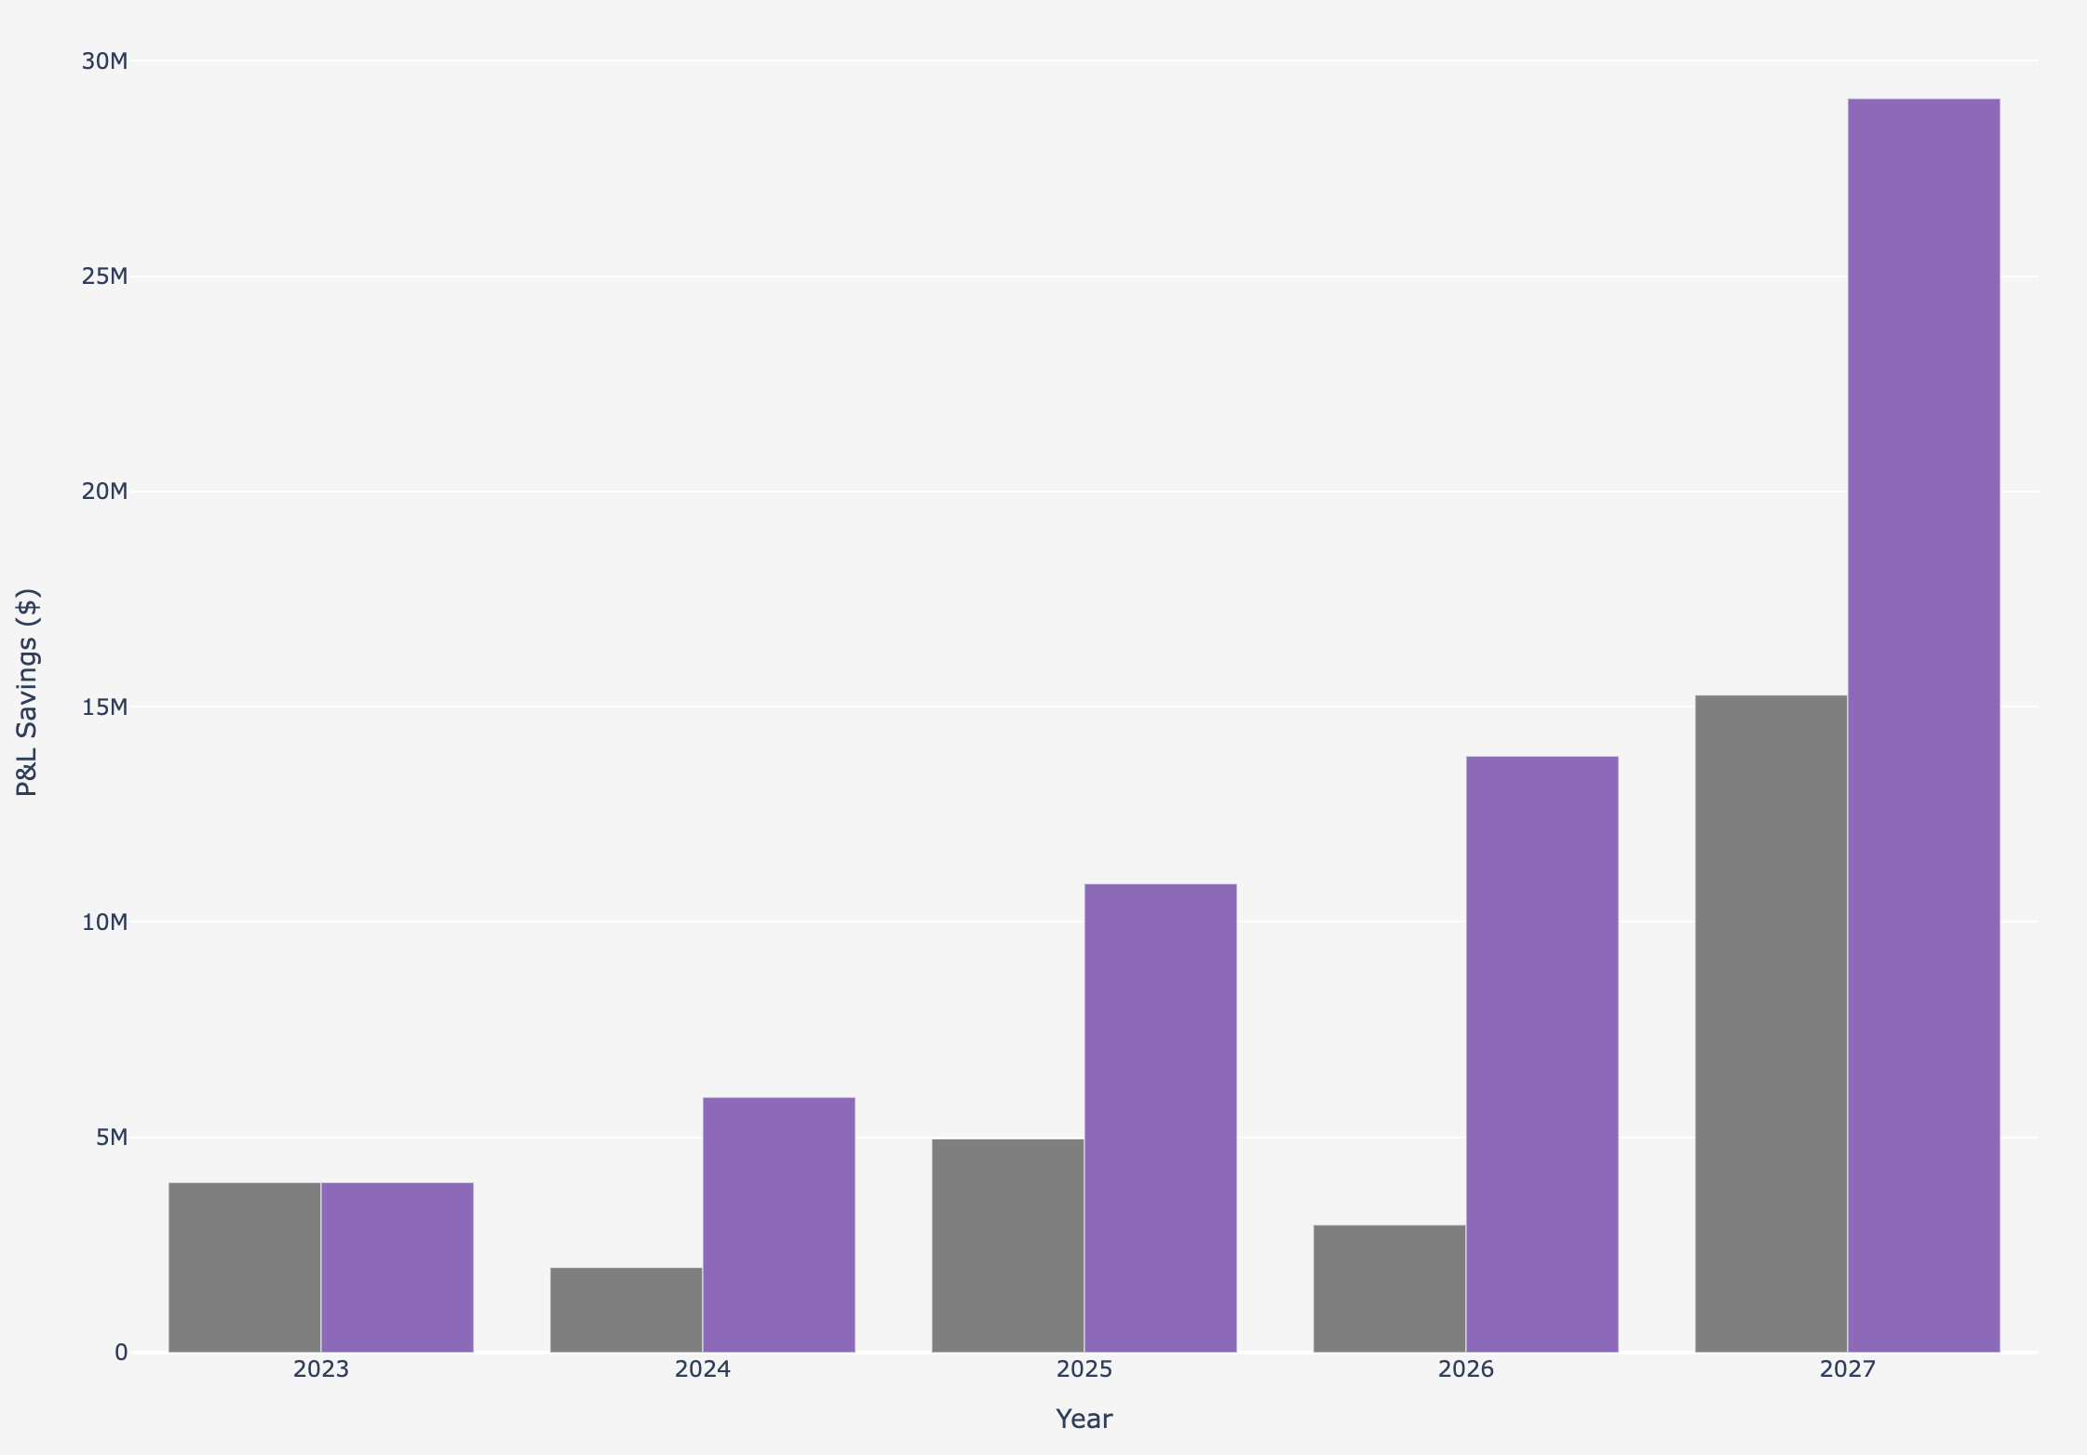
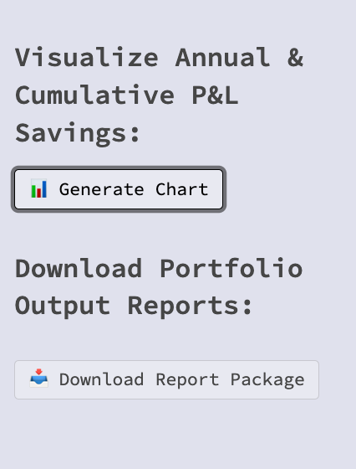

Output Analytics (Annual P&L Savings)
Annual & Cumulative Portfolio P&L Savings
Generate Visuals & Reports:

Slide 8
Next Steps

